Slide 1


Meteor Education on
the Oakland Schools Contract
CONTRACT DETAILS AND BENEFITS
Oakland Schools Contract +
Meteor Education
Meteor Education is an awardee of a variety of product lines on the Association of Educational Purchasing Agencies (AEPA) Furniture contract awarded by Oakland Schools.
^{Bid/Contract # 022-A-MI}
Initial Contract Start 3/1/2022
Yearly renewals available through 2/28/2026
^{Brandon Hillman, ALEP}
^{Director of Market Development}
²³¹⁻⁷⁴⁰⁻⁶³⁵¹
^{bhillman@meteoreducation.com}

Slide 2
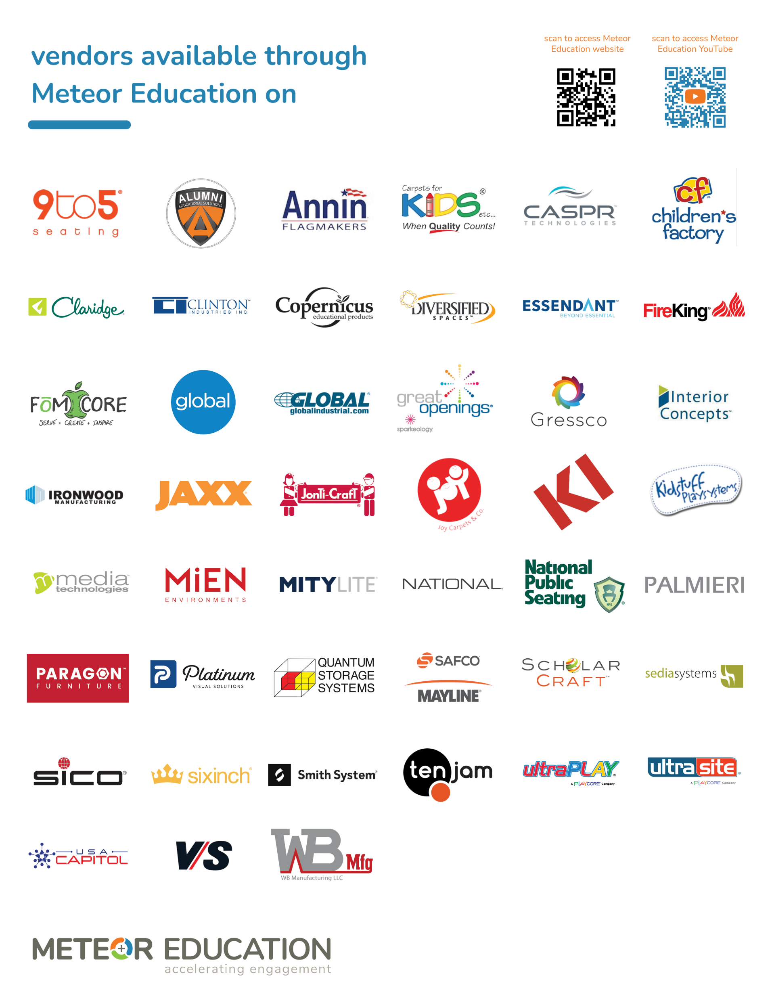

Oakland Schools

